Slide 1
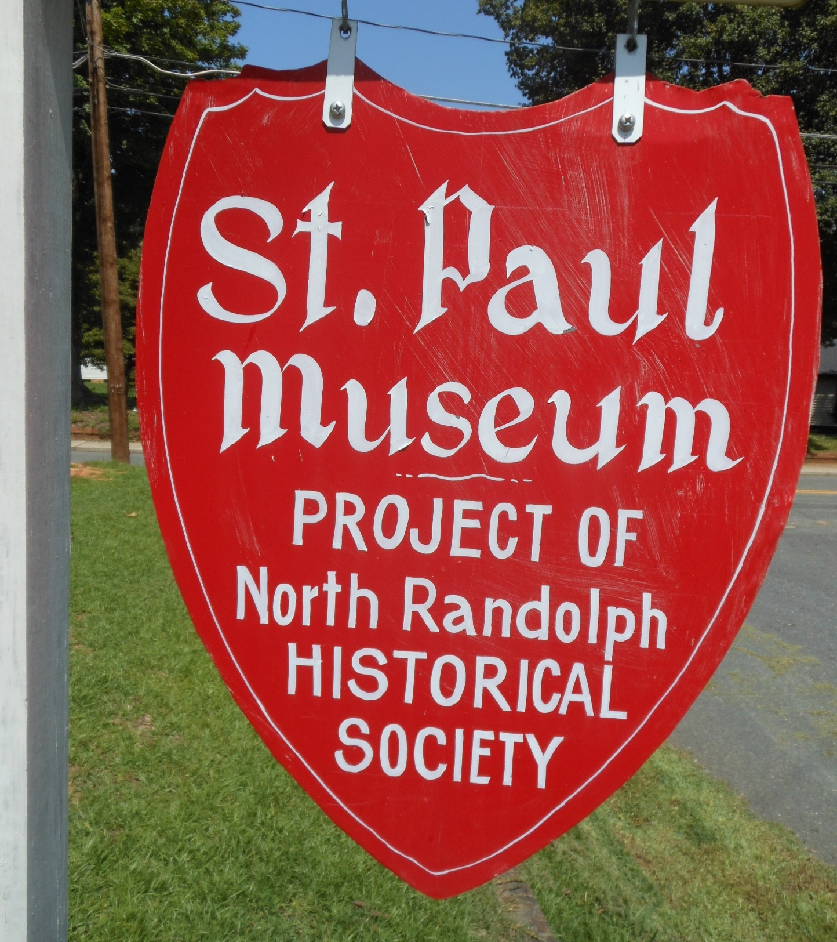
Boy Scout Eagle Project Cemetery Inventory
Connor Uehlein
Boy Scout Troop 531
Randleman, NC
November 18, 2018

Slide 2
Topics
Introductions
Project Overview
Fun Facts!
Picture Tour

Slide 3
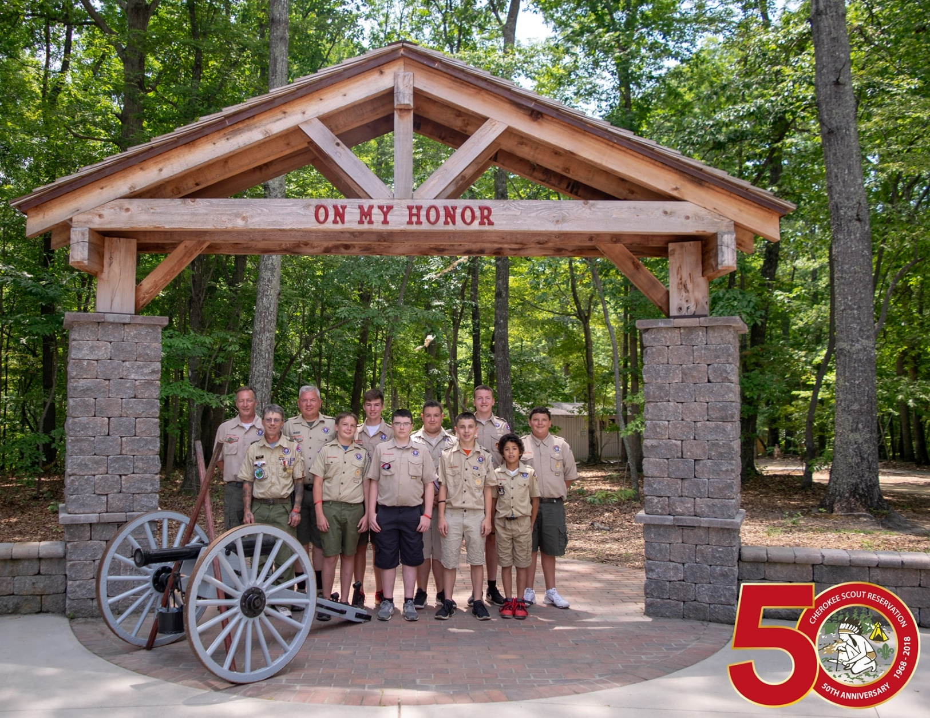
Introductions
Boy Scout Troop 531
Project Sponsors / Beneficiaries
Louise Hudson
Ellen and Steve Robbins
Peggy Woodlief

Slide 4
The Eagle Project

Slide 5
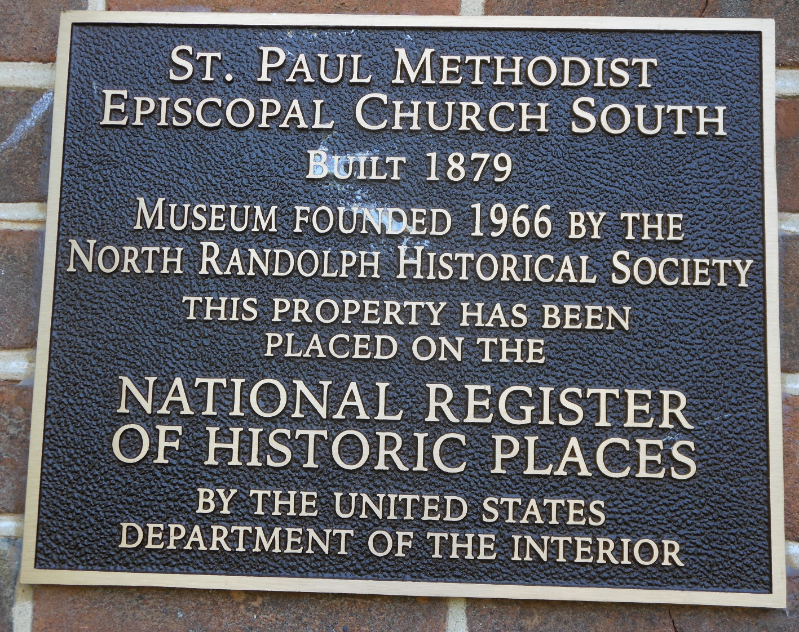
Project Overview (from North Randolph Historical Society letter)
St. Paul’s cemetery is historically important
Many old graves (the oldest is 1869)
Graves reflect the community of Randleman in that all economic and social sectors are represented: founding families, store owners, mill owners and people who worked in the mills, doctors, ministers, generations of many families, Confederate and Union soldiers and veterans of WWI and WWII —all the diversity of a small town as it grew and developed.
Many graves of infants and young children as well as mothers who died as a result of childbirth.
Much can be learned here (and in any old cemetery) of the demographics of the nineteenth and early twentieth centuries, times before antibiotics and modern medical practices.

Slide 6
Project Overview What needs to be done?
Need a scale map developed of the entire graveyard, showing the location of every grave.
On this map we would like the name of each grave occupant.
We would like a listing of each grave, along with all information that is on the gravestone.
This list would be coordinated with the map by means of a simple numbering system.
Those looking for the location of a particular grave would consult the listing, organized (probably) alphabetically by last name, note the number assigned to this site on the map, and then locate the grave by consulting the map.
The inventory and the map needs to be in a format that will permit the adding of additional graves and names. Although the graveyard is considered filled, there are still vacant places in existing family plots.

Slide 7
The Plan
Create a mapping strategy
Create data collection sheets
Collect data
Enter it into a database
Map it
Add a few pictures
Done!

Slide 8
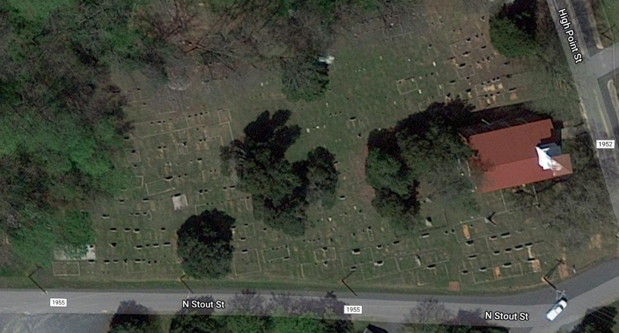
Google Maps View of Cemetery

Slide 9
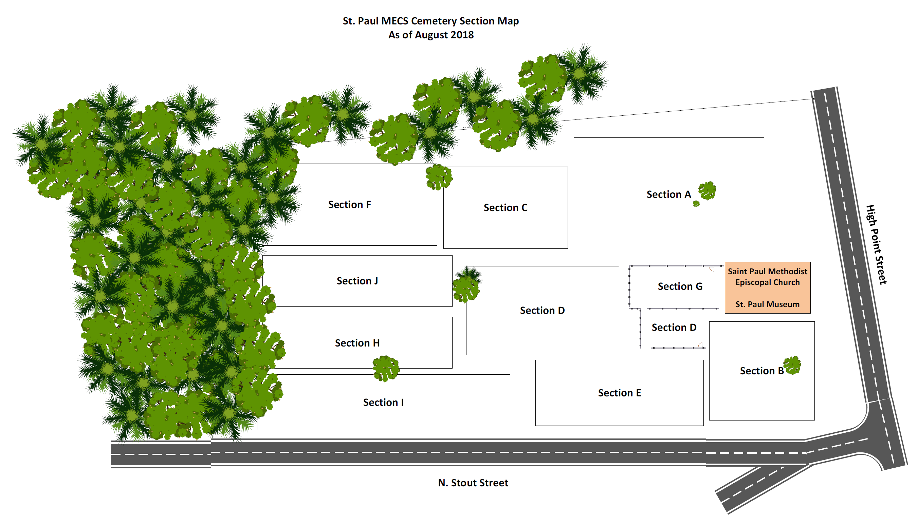
Cemetery Sections after Determining “Grids”

Slide 10
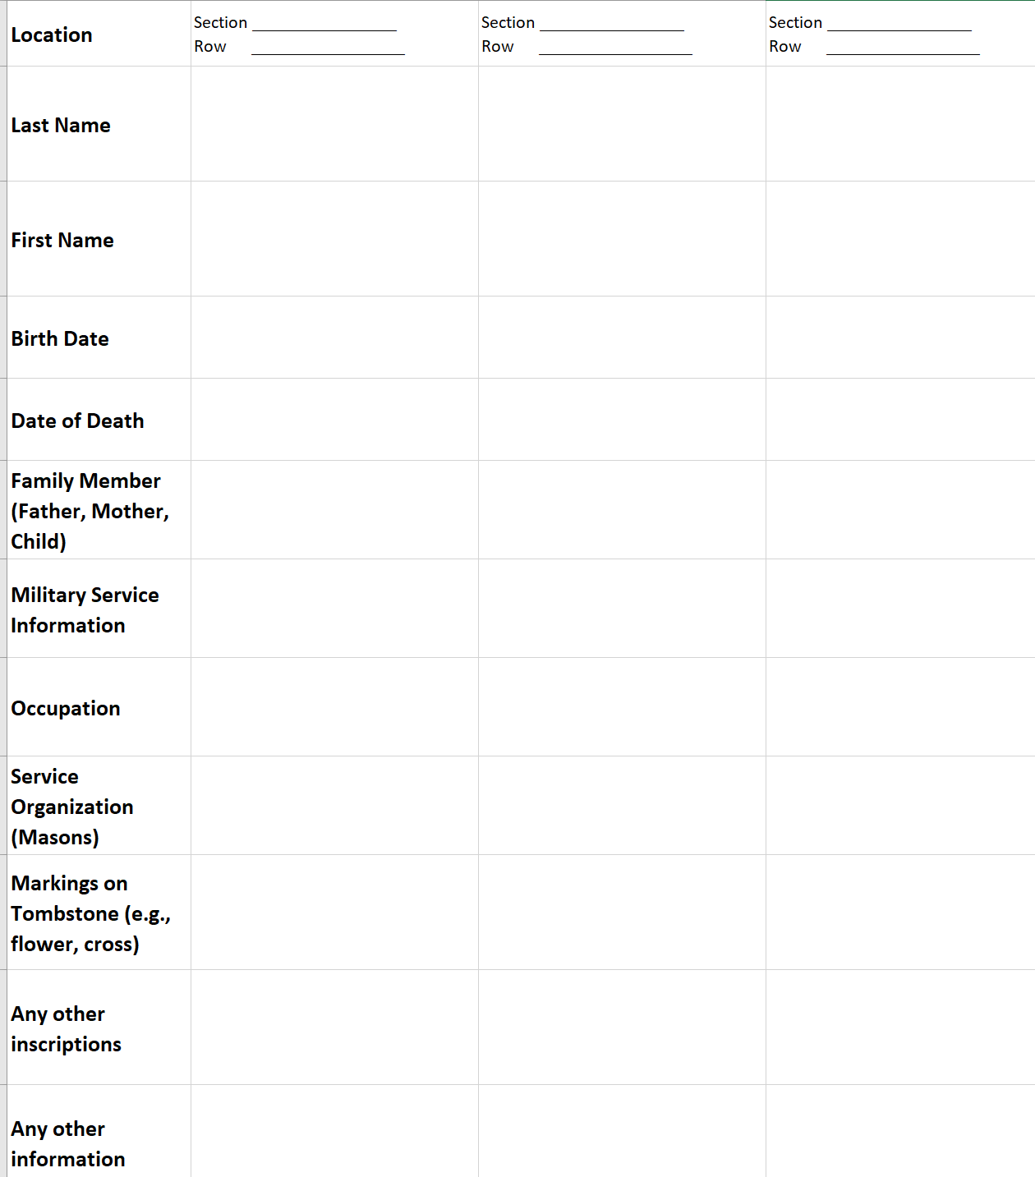
Data Collection Sheet

Slide 11
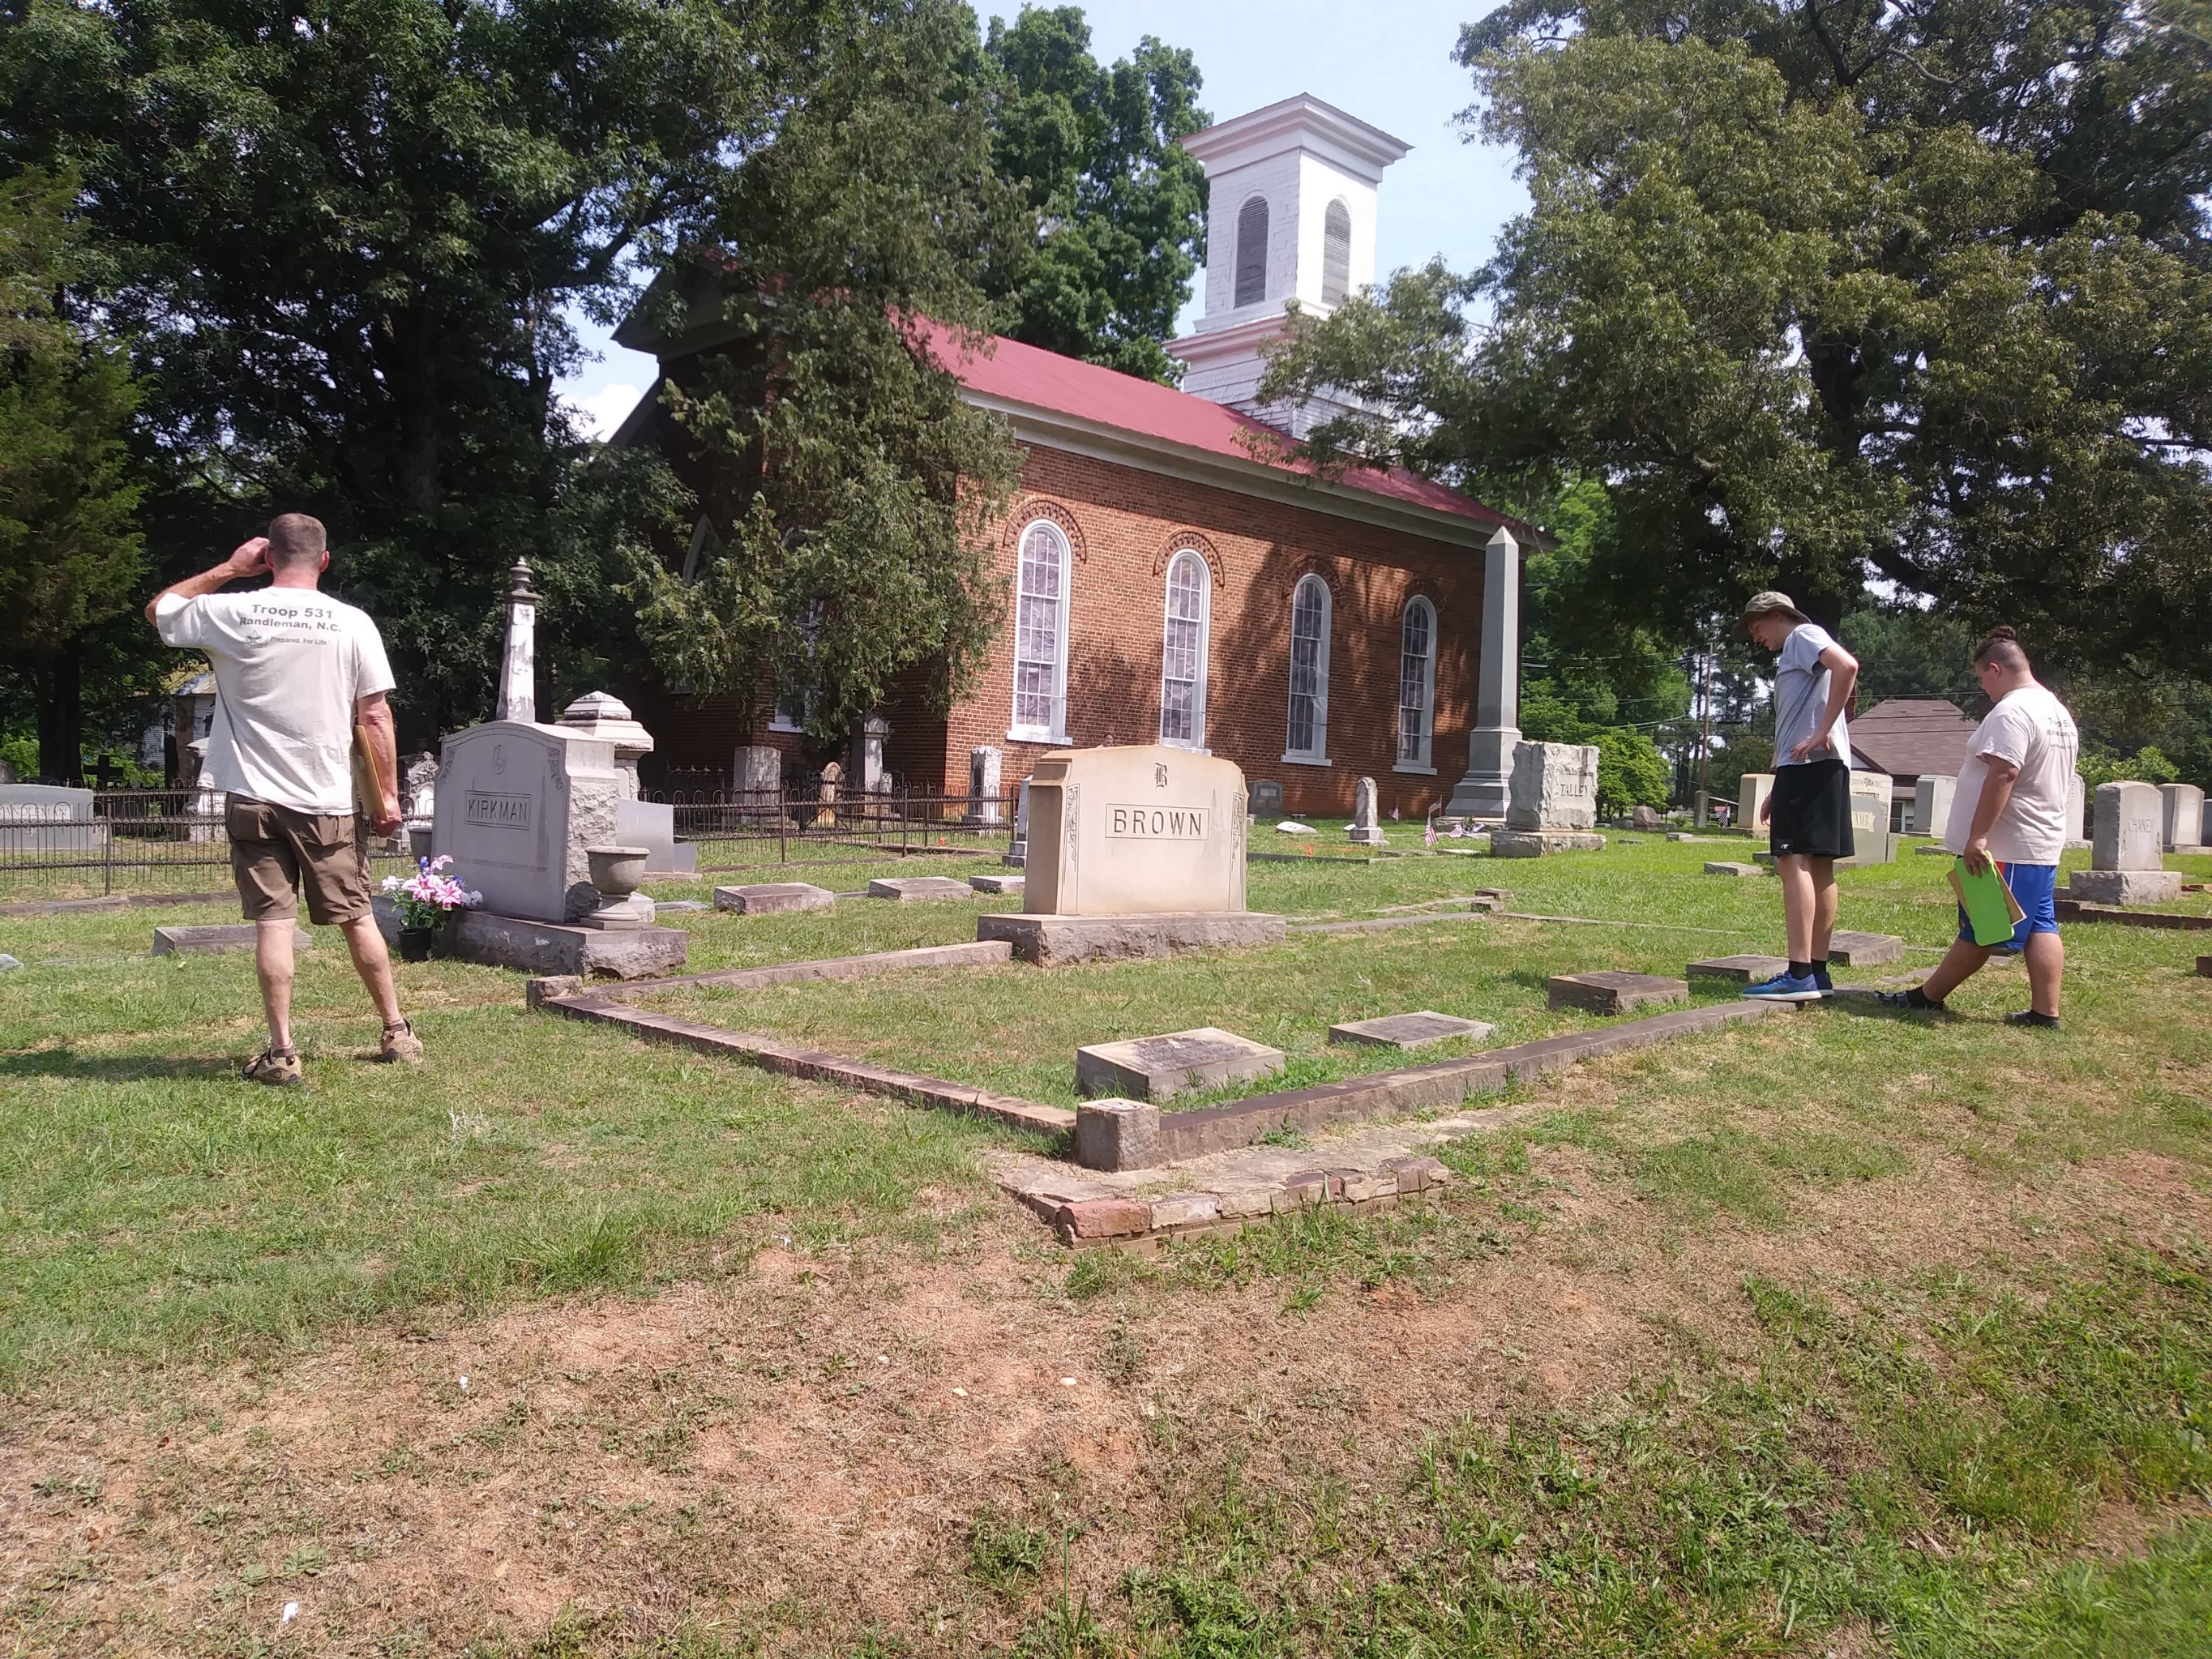
You want us to do WHAT???

Slide 12
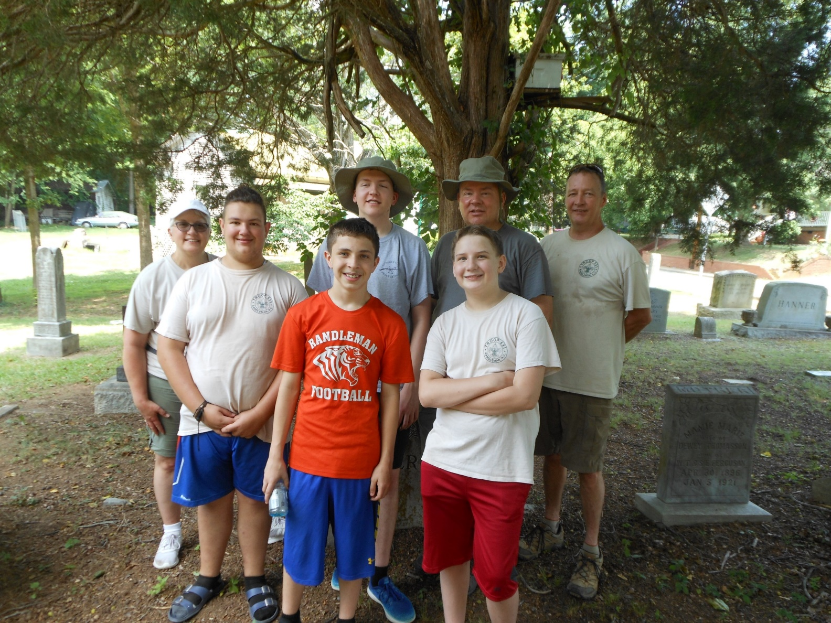
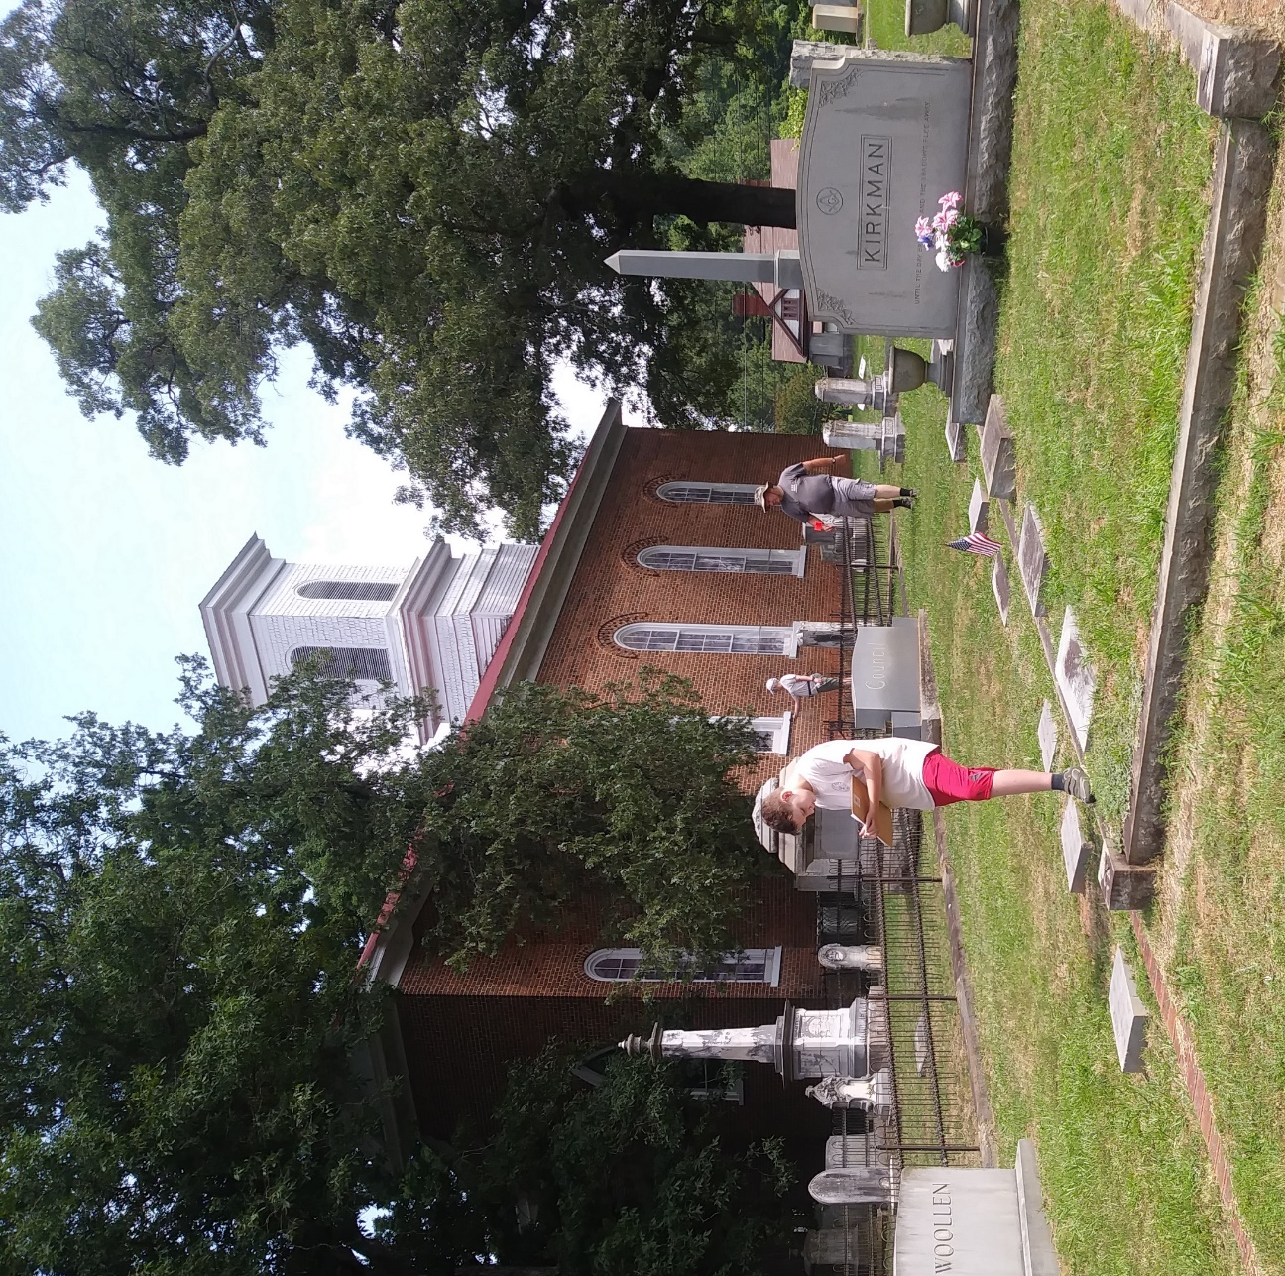
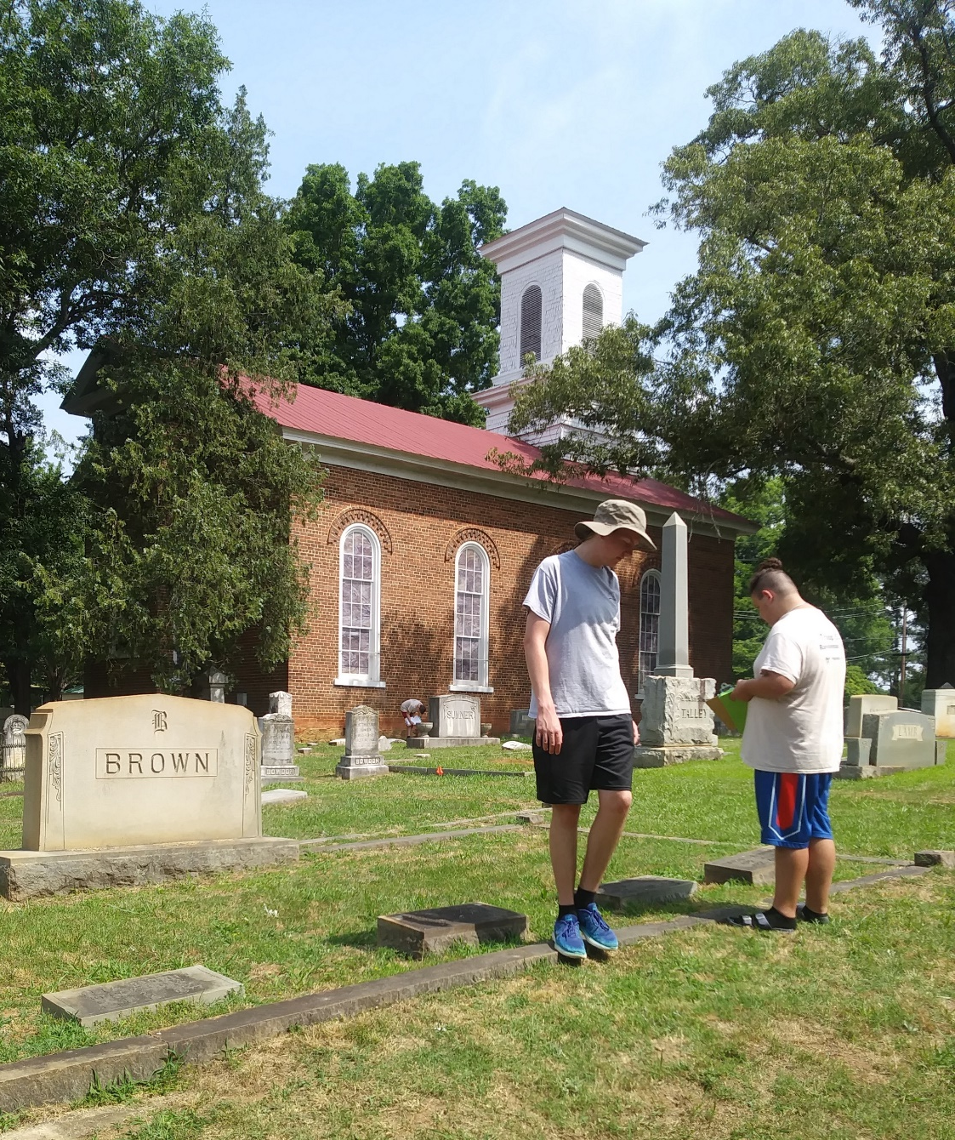
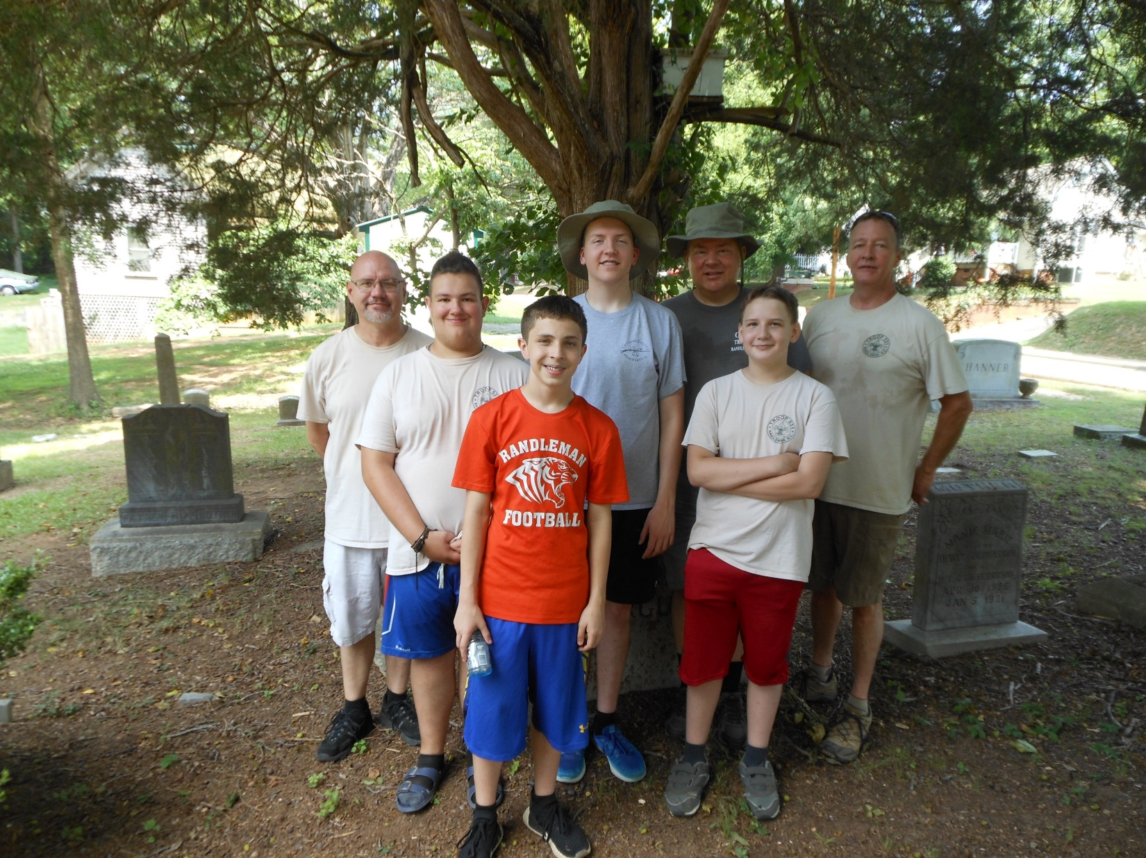

Slide 13
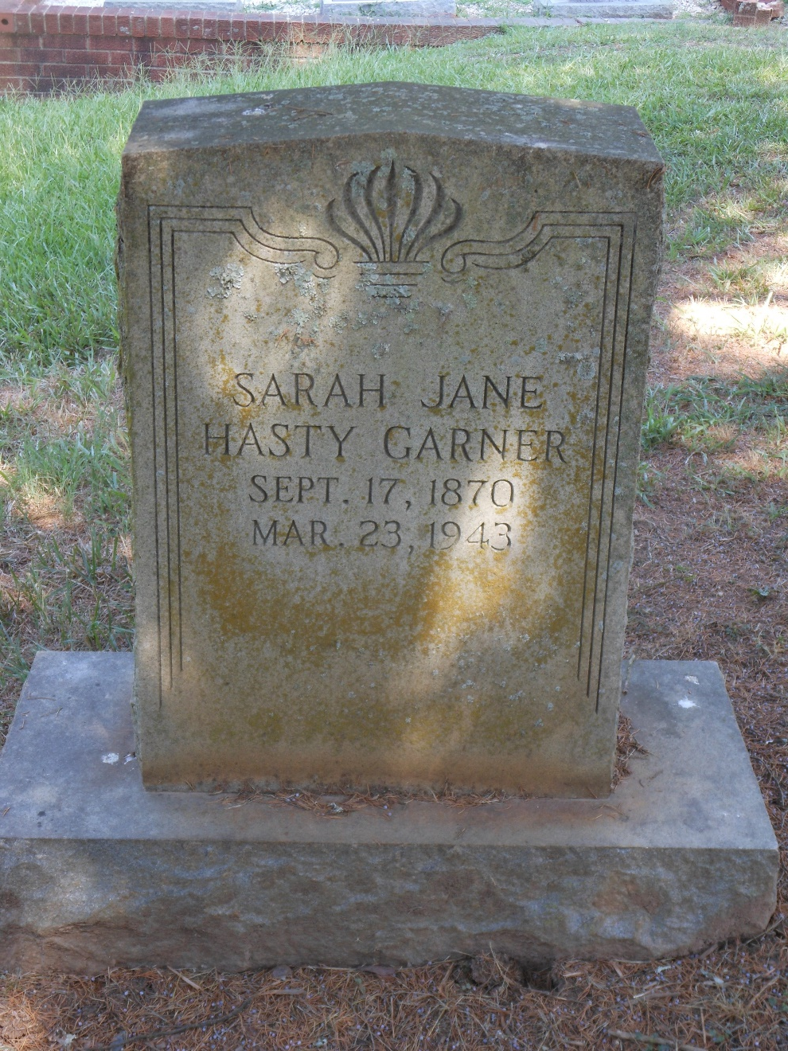
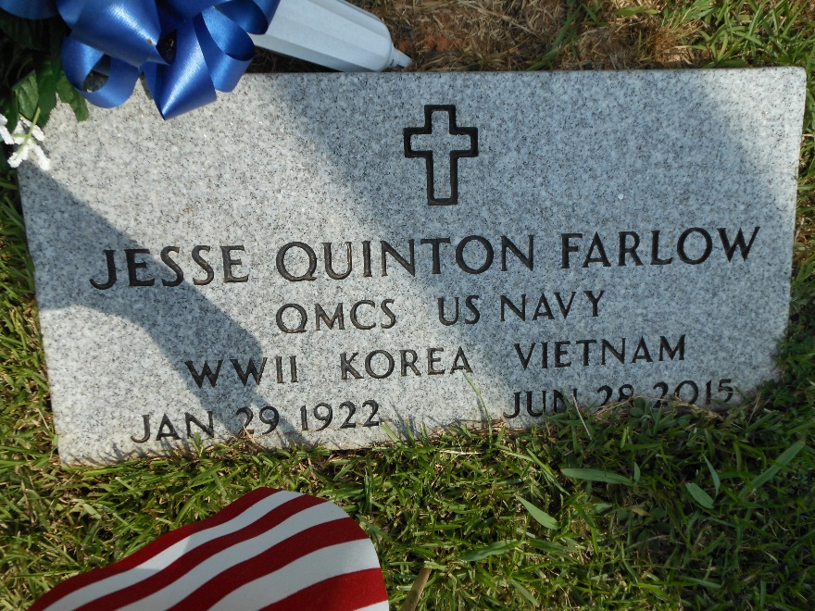
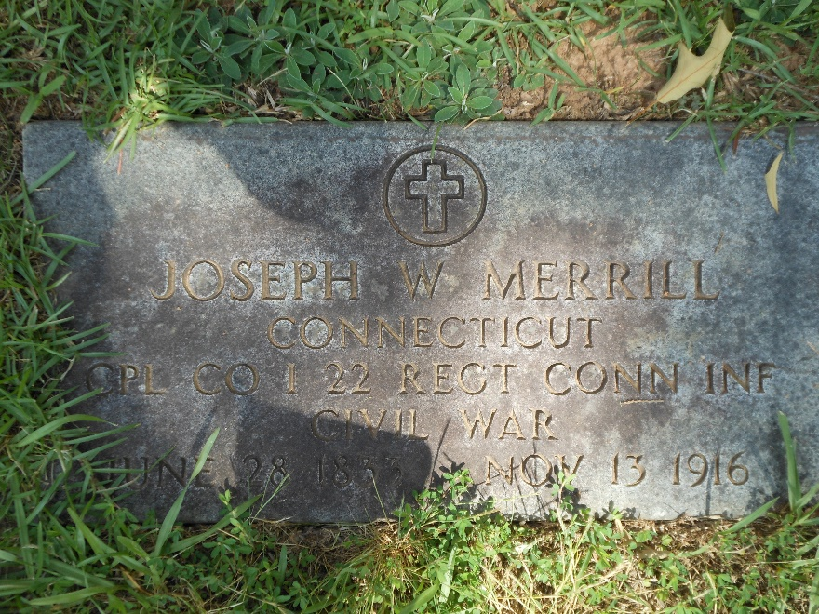
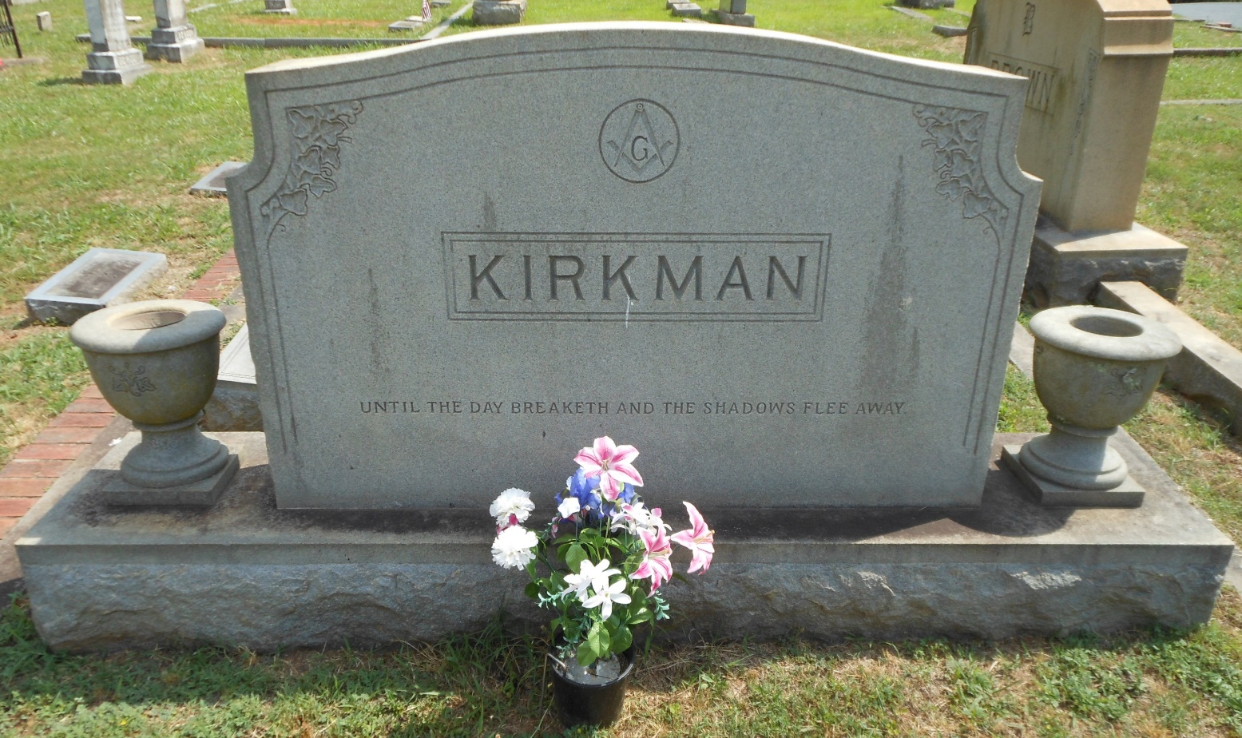
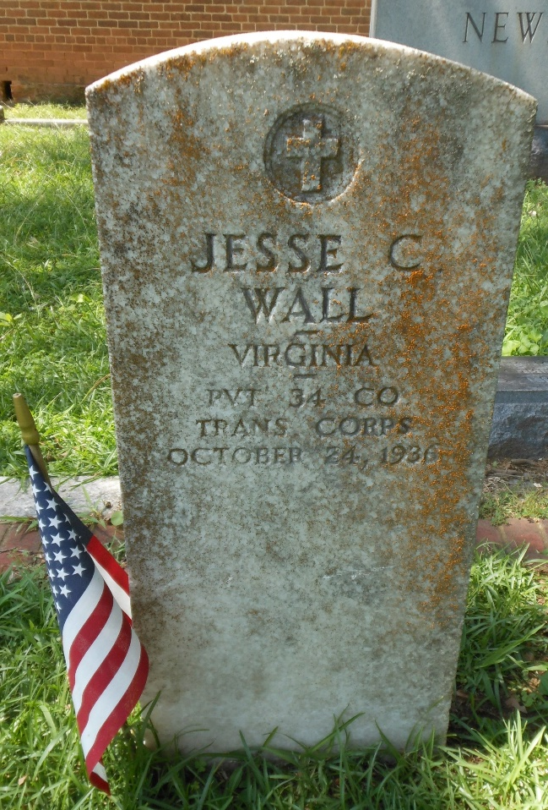
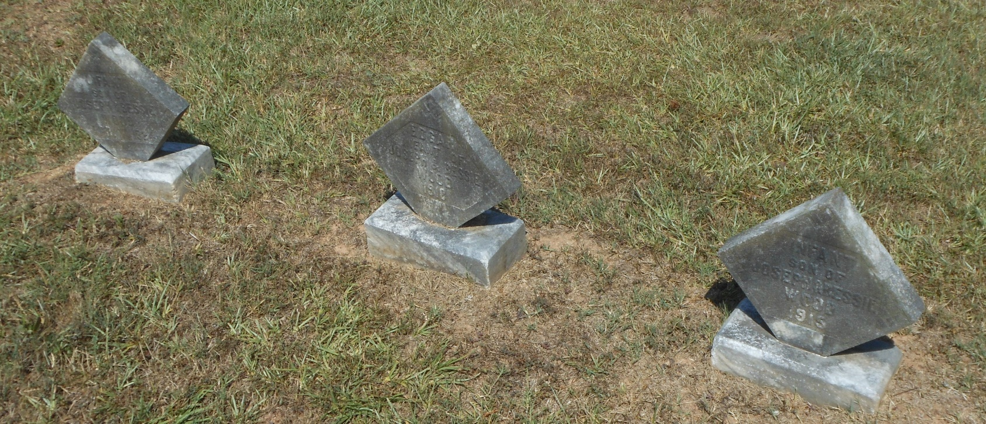
Sample Gravesites

Slide 14
Unexpected Challenges
Weather stained and worn tombstones
Cracked / broken headstones
Condition of cemetery landscaping
Reading the writing of my fellow Scouts on the data collection sheets!
How much data validation would be needed
Snakes!!!

Slide 15
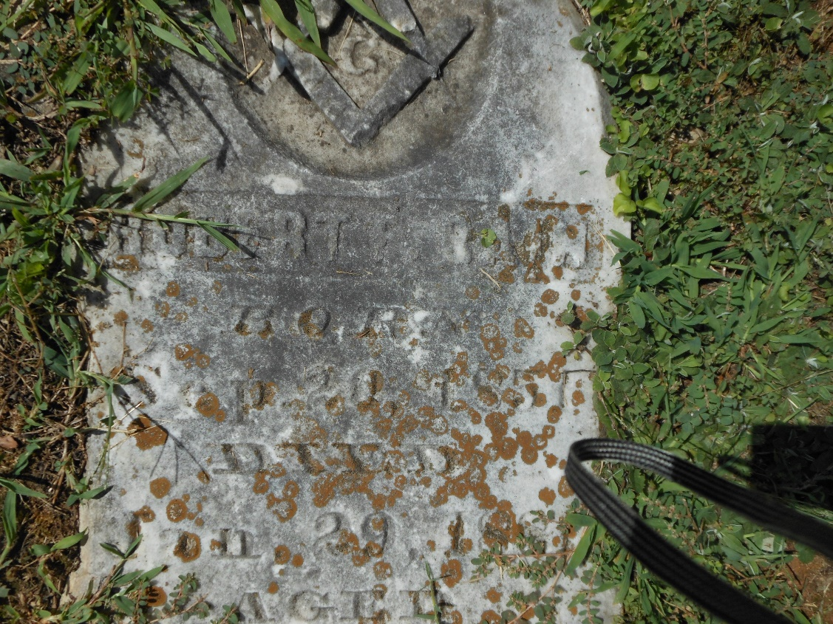
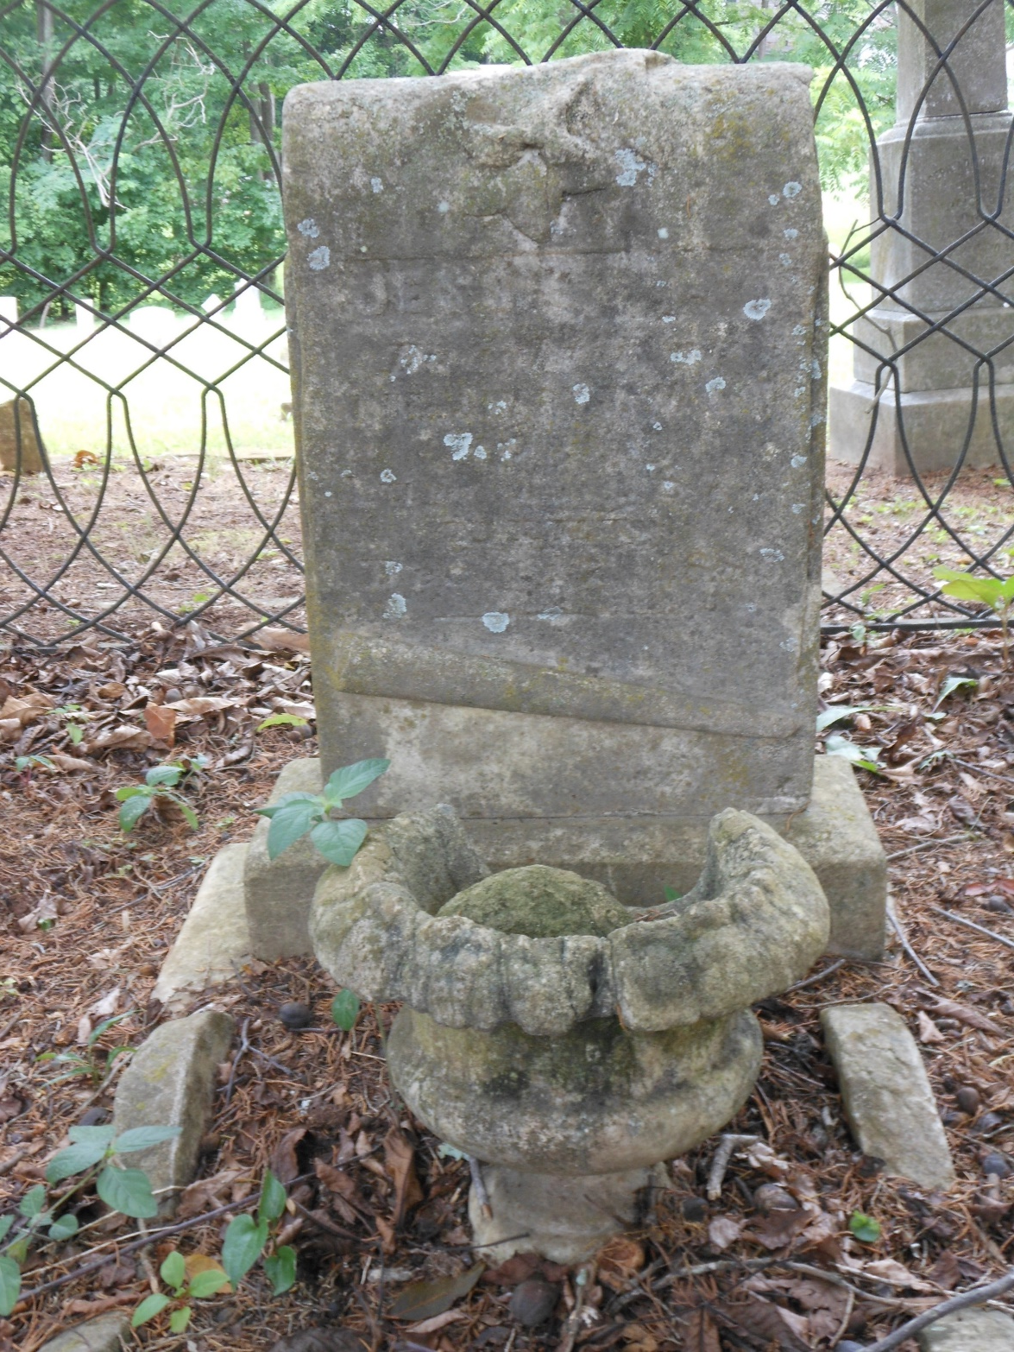
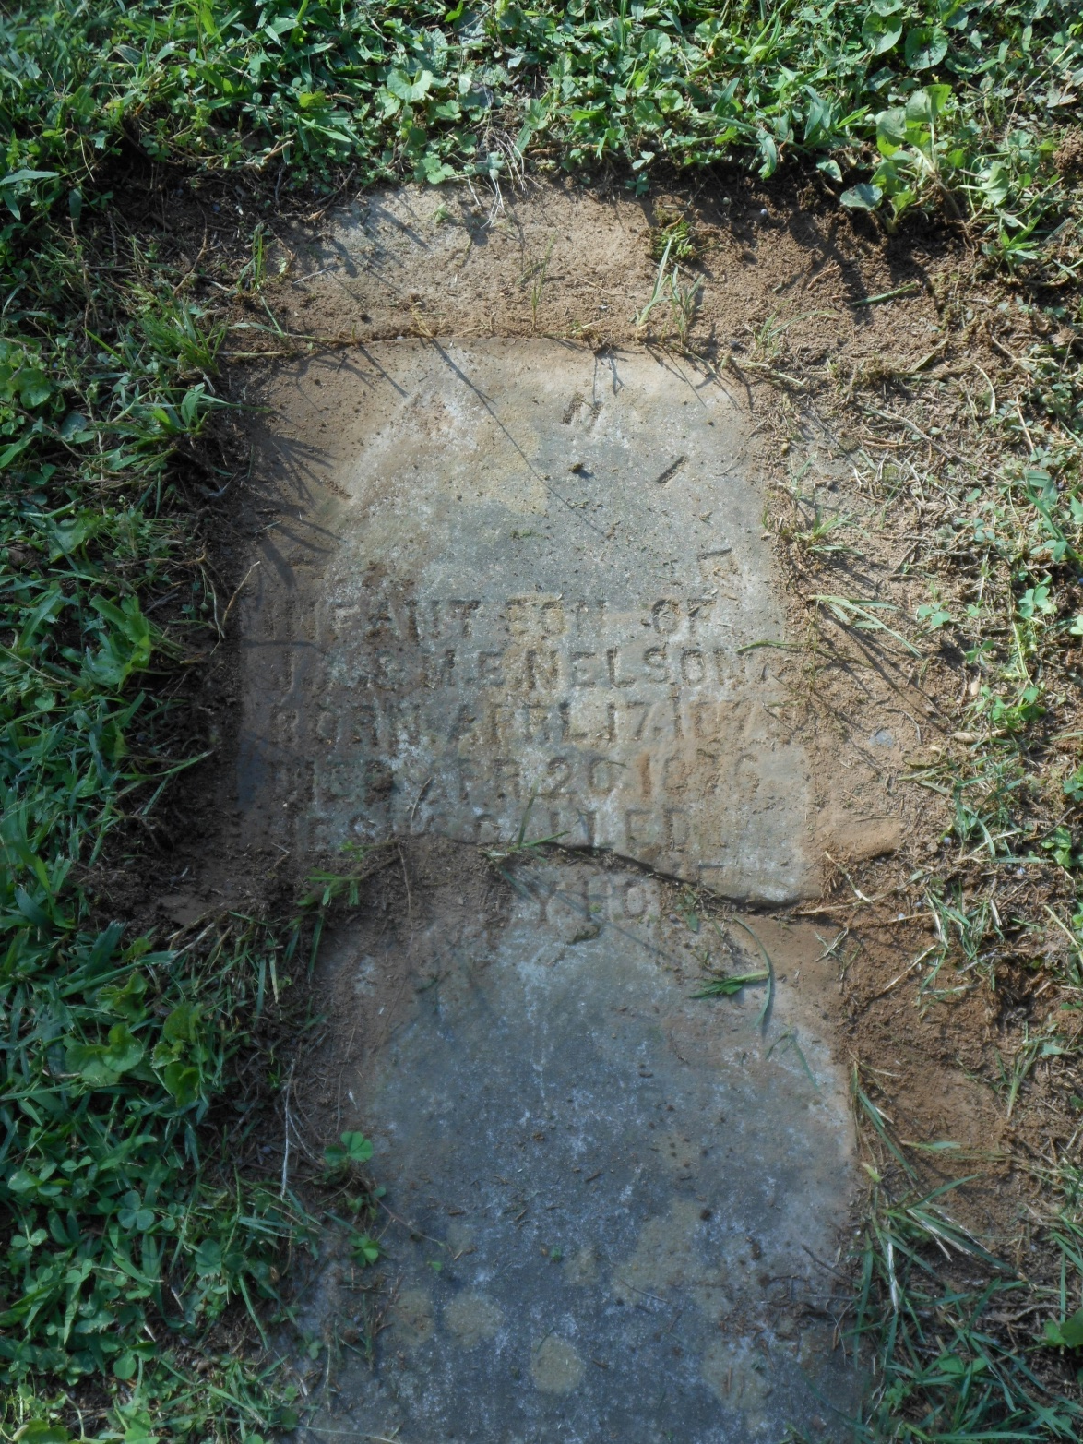
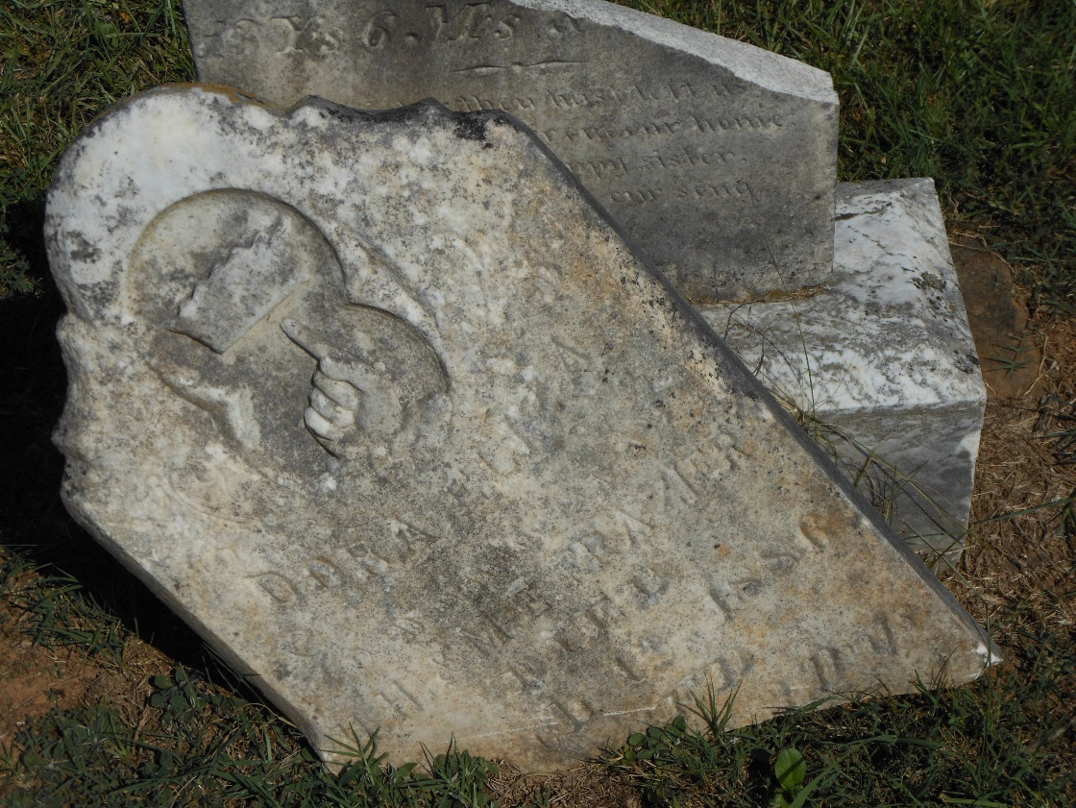

Slide 16
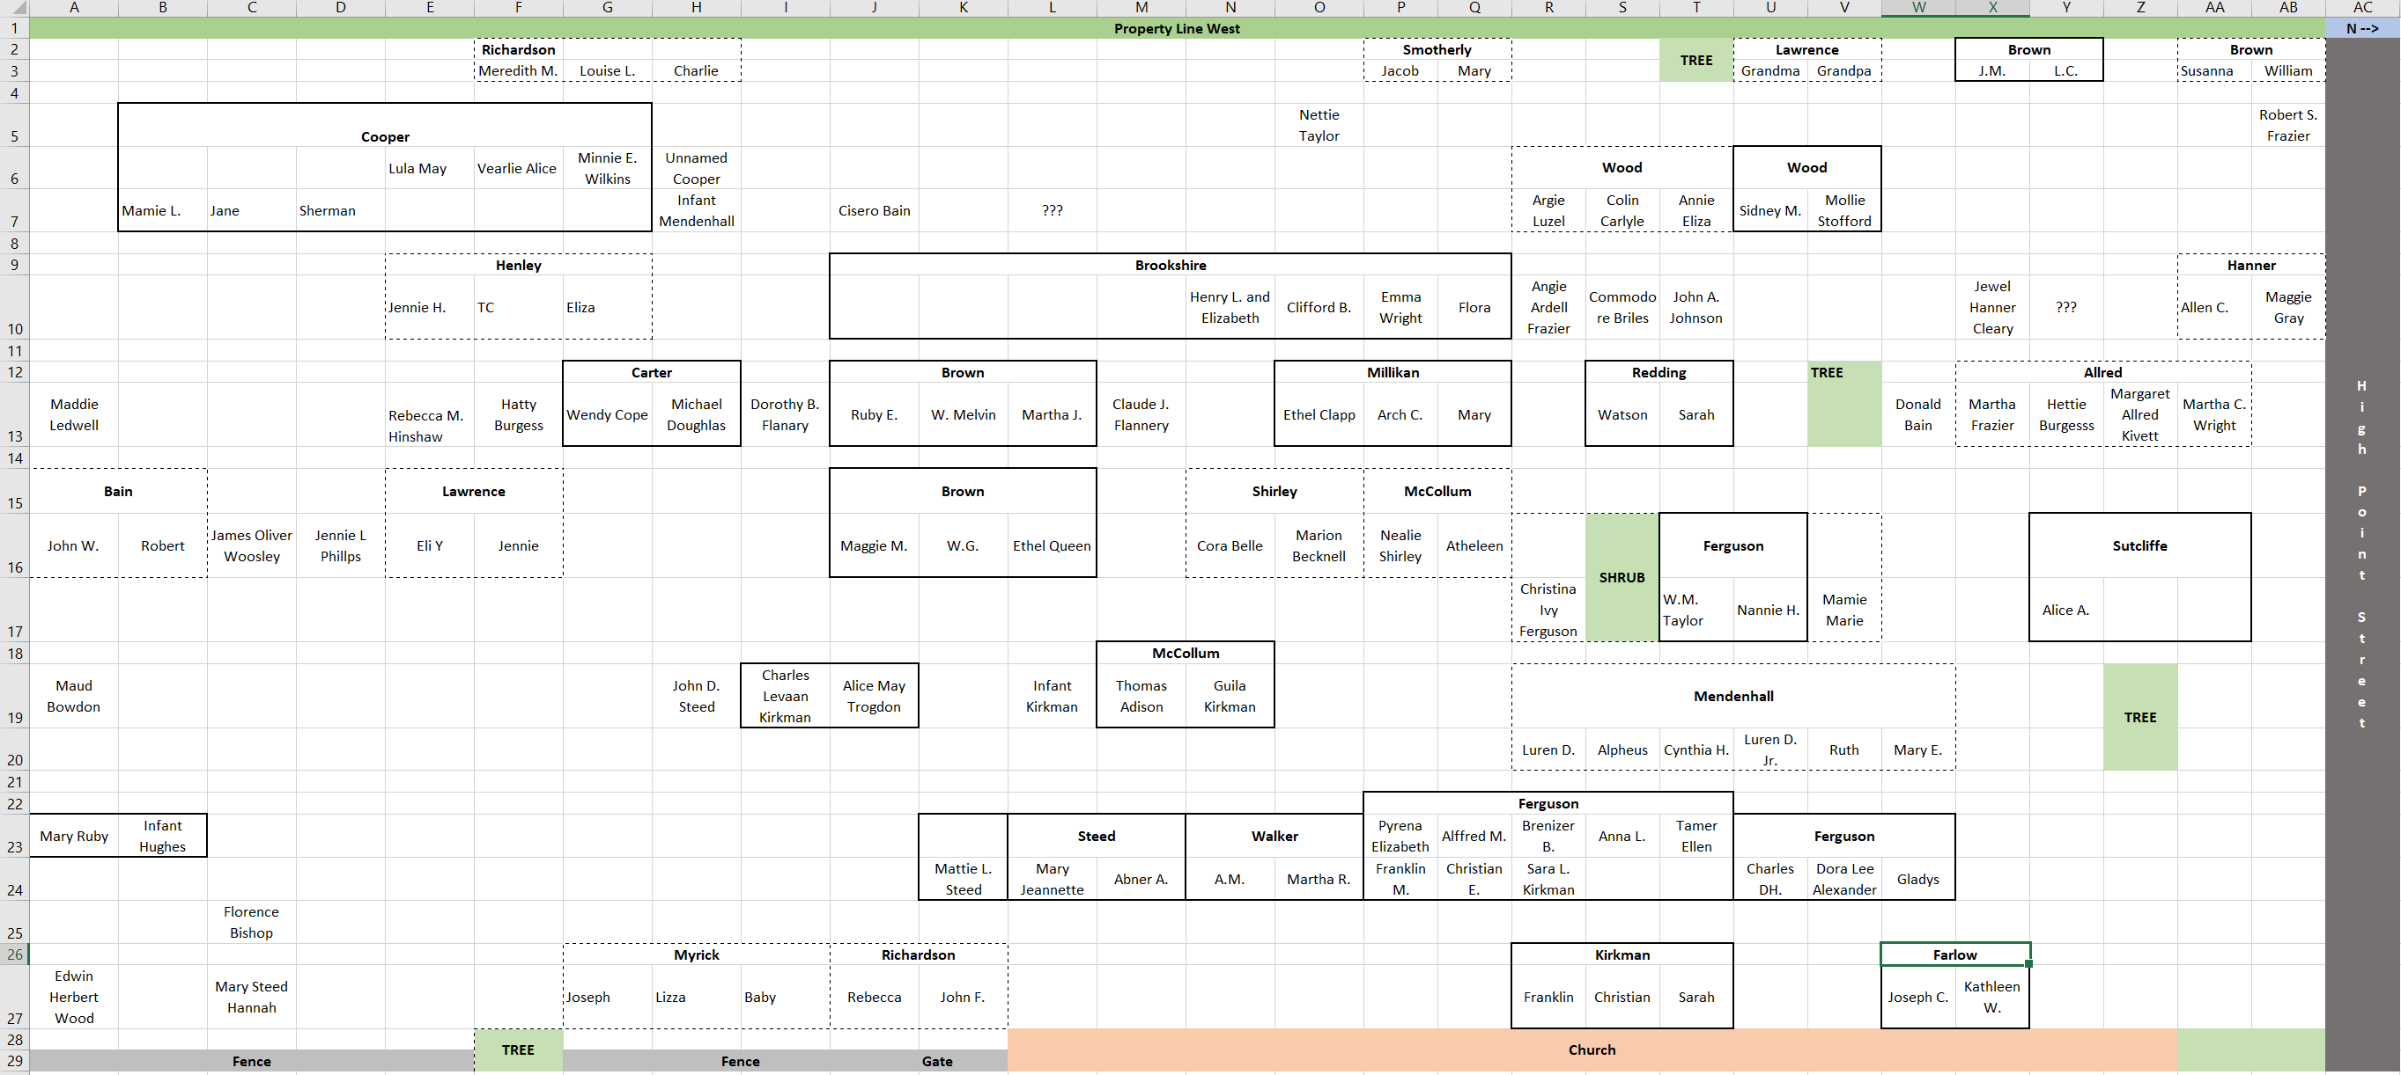
The Results – A Map

Slide 17
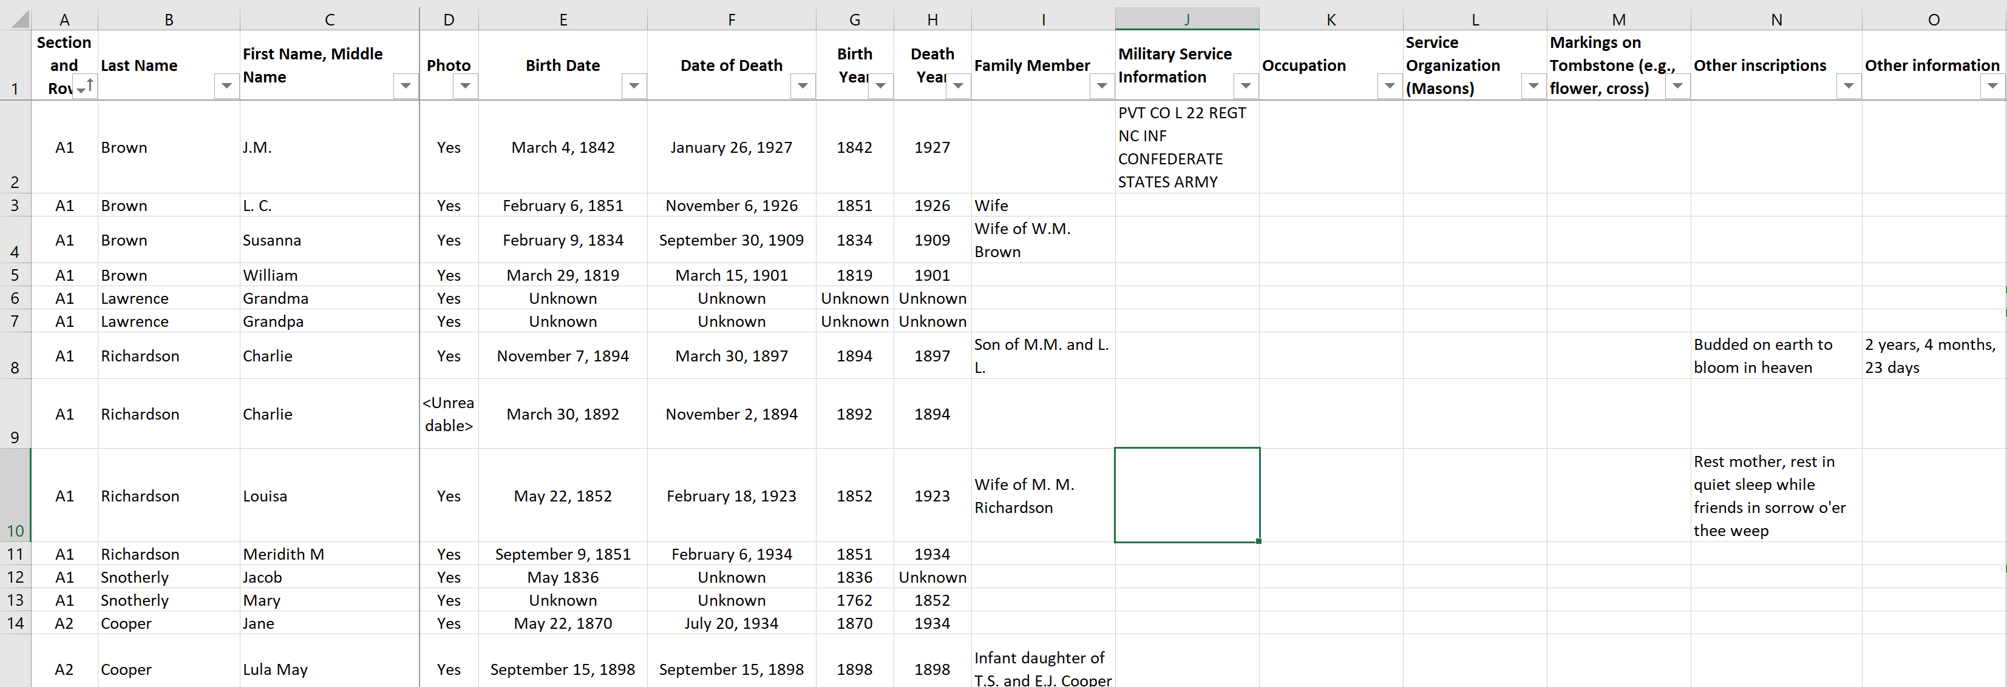
The Results – Spreadsheet Inventory

Slide 18
The Bonus – A Picture Book of Veterans

Slide 19
Fun Facts
Eagle Project in total took 141 hours, including paperwork, meetings, data gathering and producing final results
671 grave markers were identified
Birth dates ranged from 1762 to 2009
Death dates ranged from 1827 to 2016
There were 33 Veterans who honored America by serving in the Civil War, World War I, and World War II, Korea and Vietnam
There were a significant number of tragedies – with over 10% of the population dying before the age of 10
There was also some unexpected longevity, expected in this time period, with about 7% of the people living to 90 years of age or better – including a few centenarians
Notes:
I want to share with you a few statistics that we discovered along the way

Slide 20
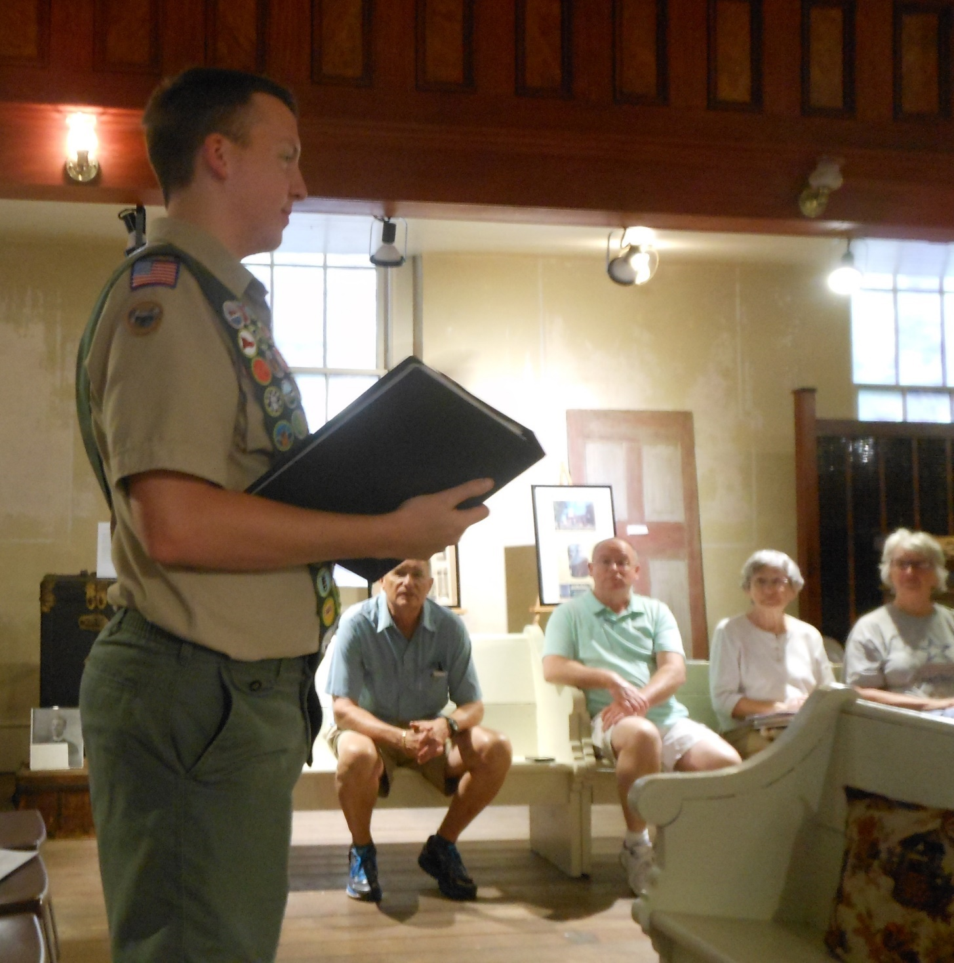
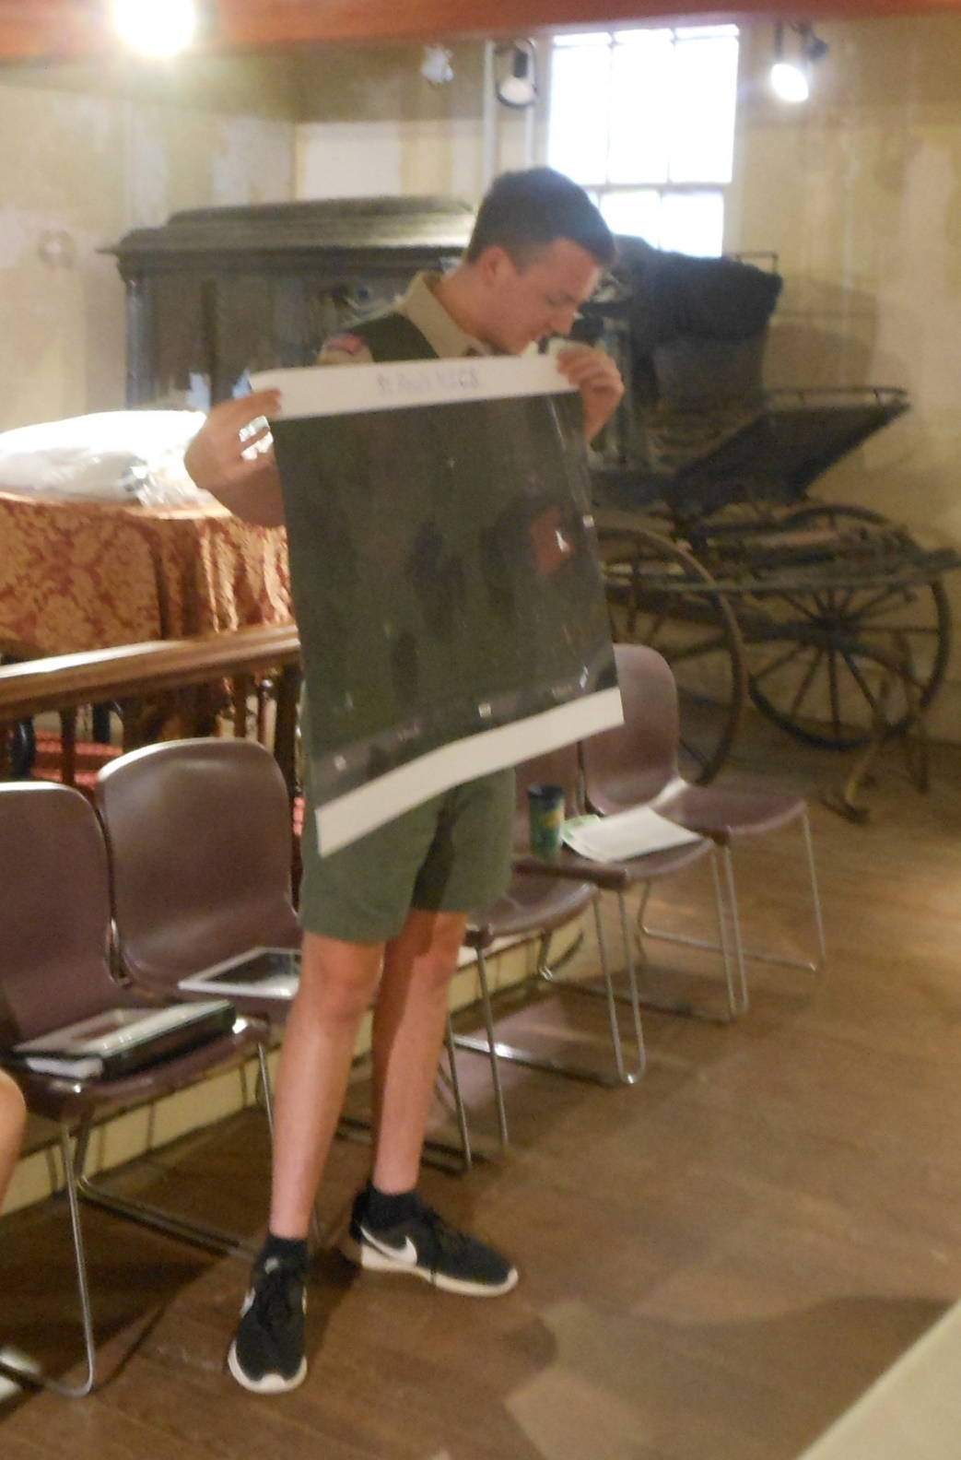
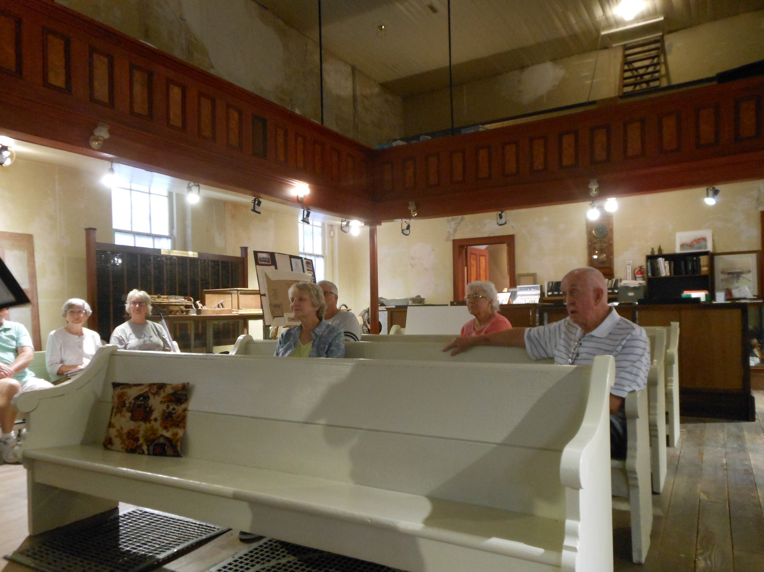
Presentation – September 6, 2018

Slide 21
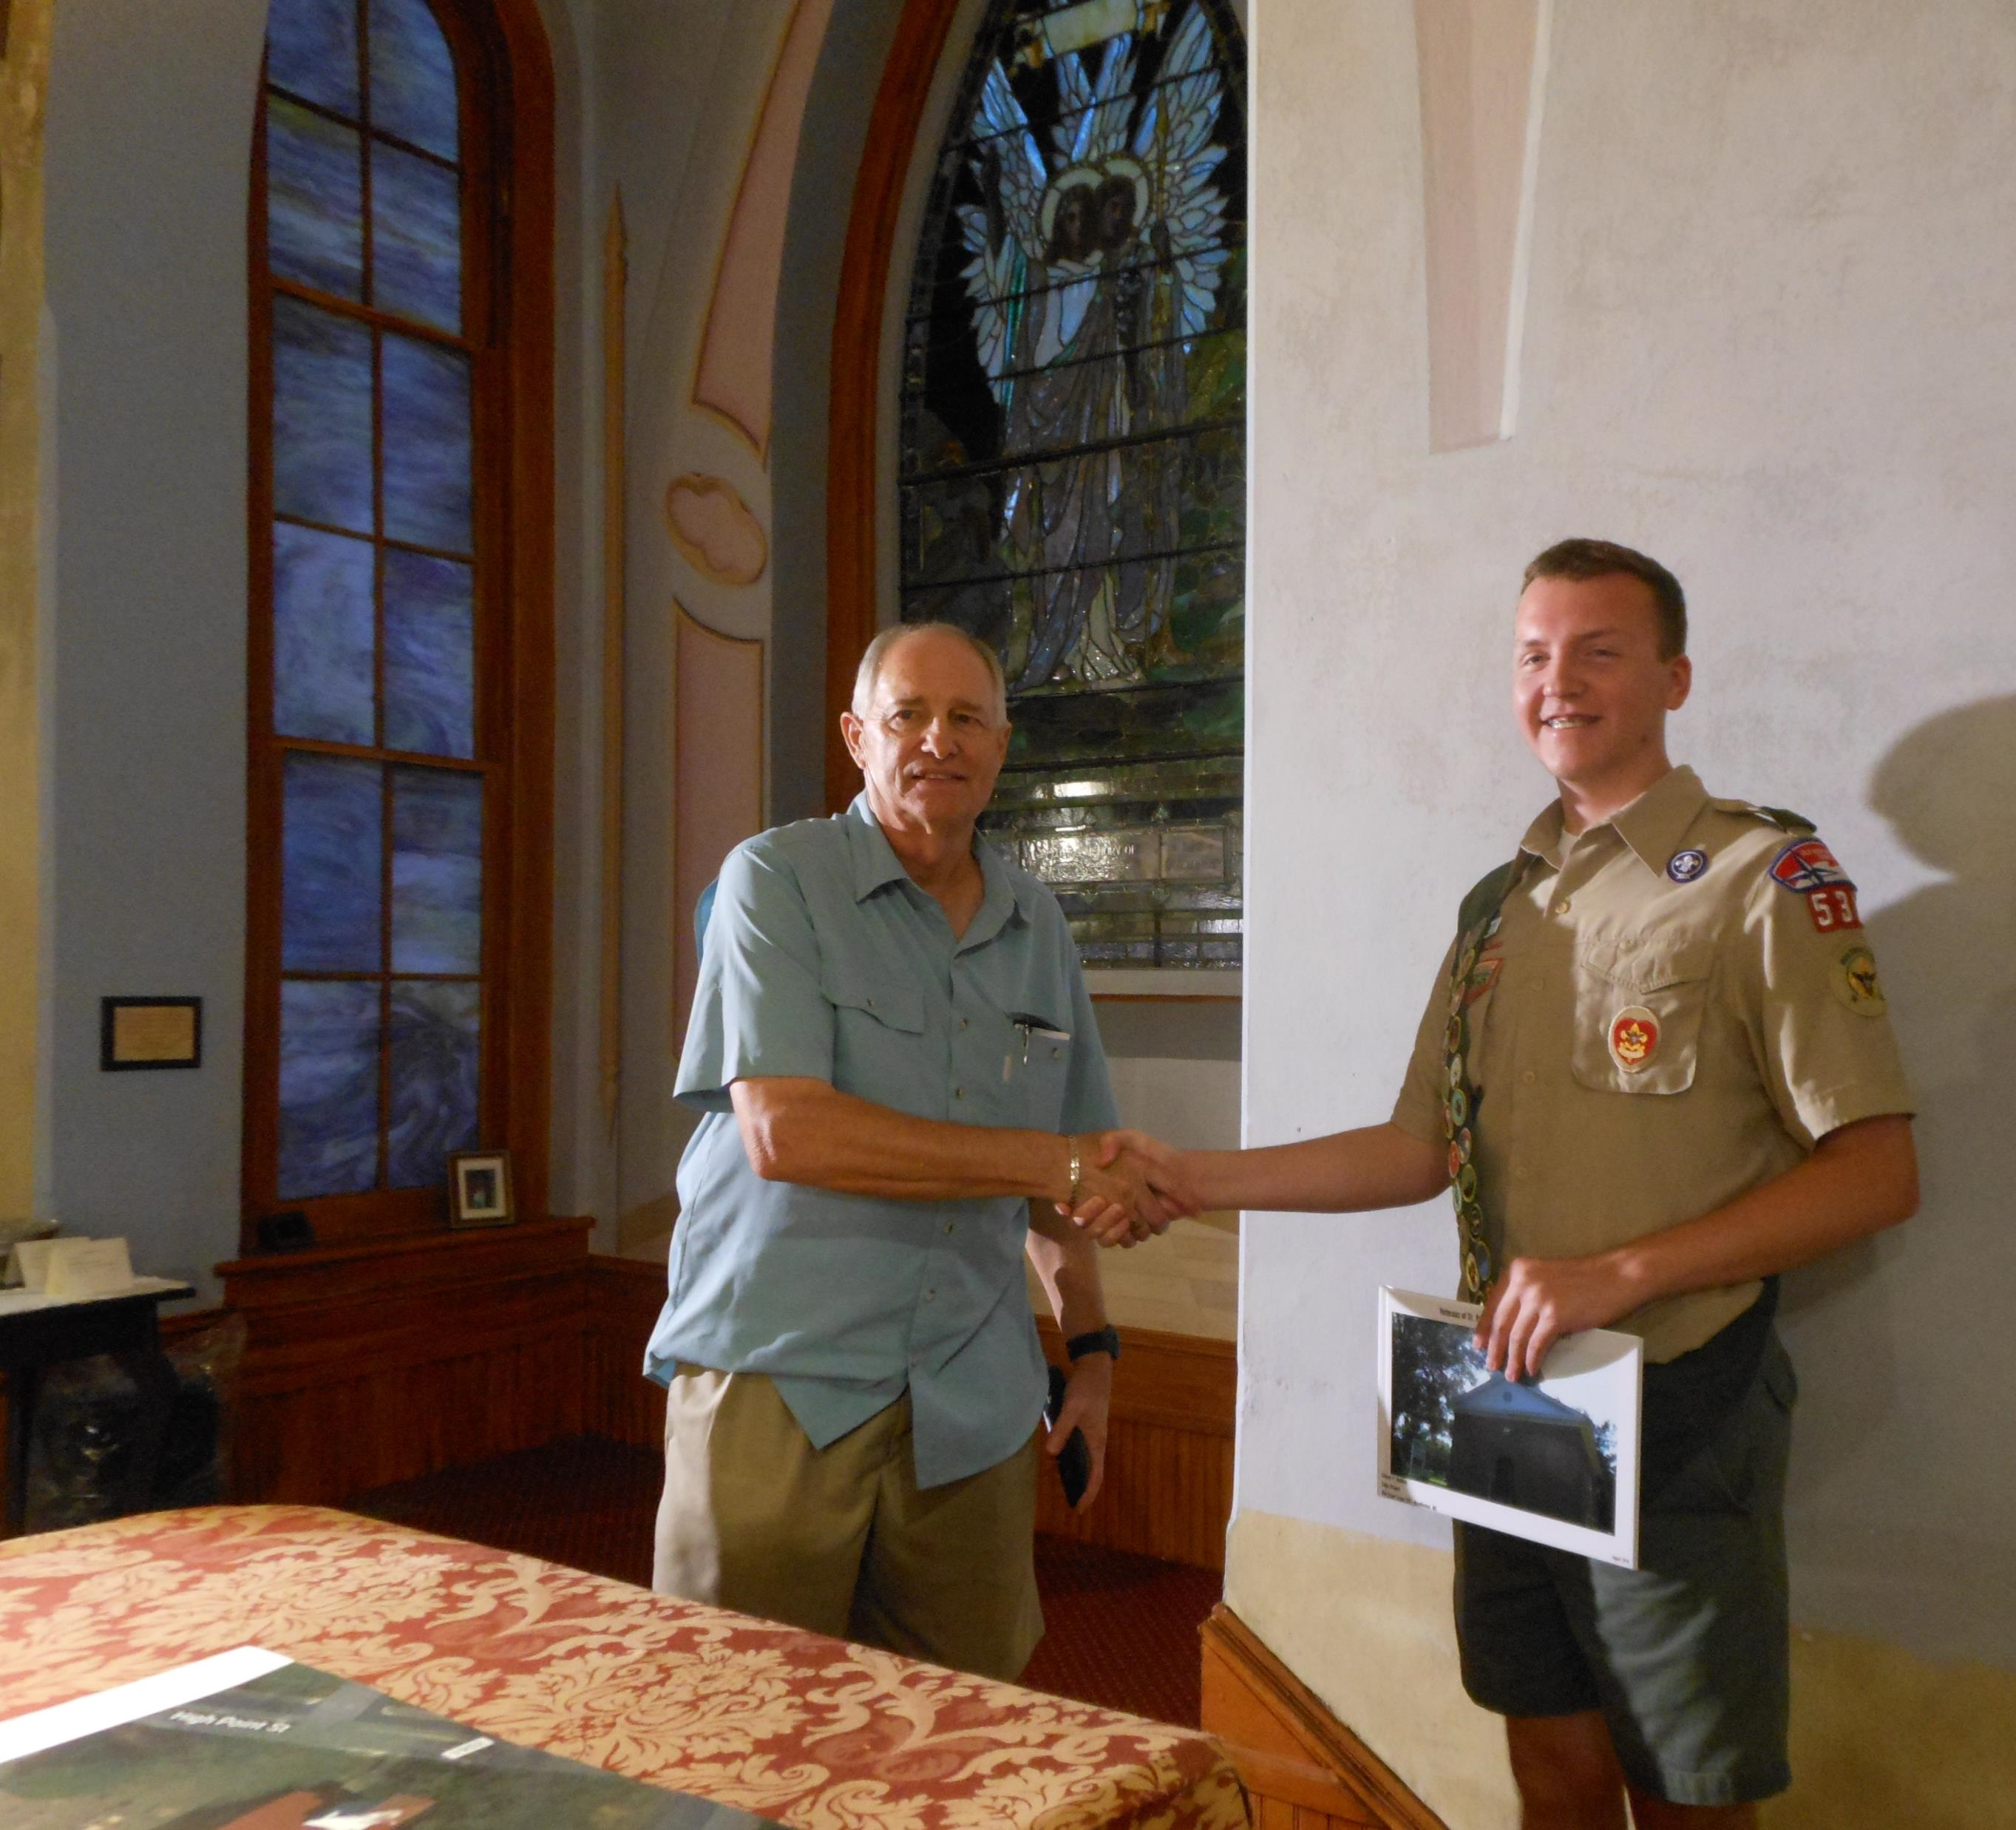
Mission Accomplished!

Slide 22
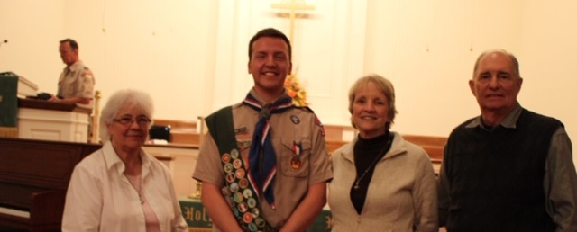
Thank you for your sponsorship and support!

